Slide 1
CASCADING STYLE SHEET
DAY - 2

Slide 2
What is CSS ?
CSS is a language that we use to implement styling in a web site
CSS stands for Cascading Style Sheets
CSS describes how HTML elements are to be displayed on screen, paper, or in other media
CSS saves a lot of work. It can control the layout of multiple web pages all at once
External stylesheets are stored in CSS files.
Files ends with .css

Slide 3
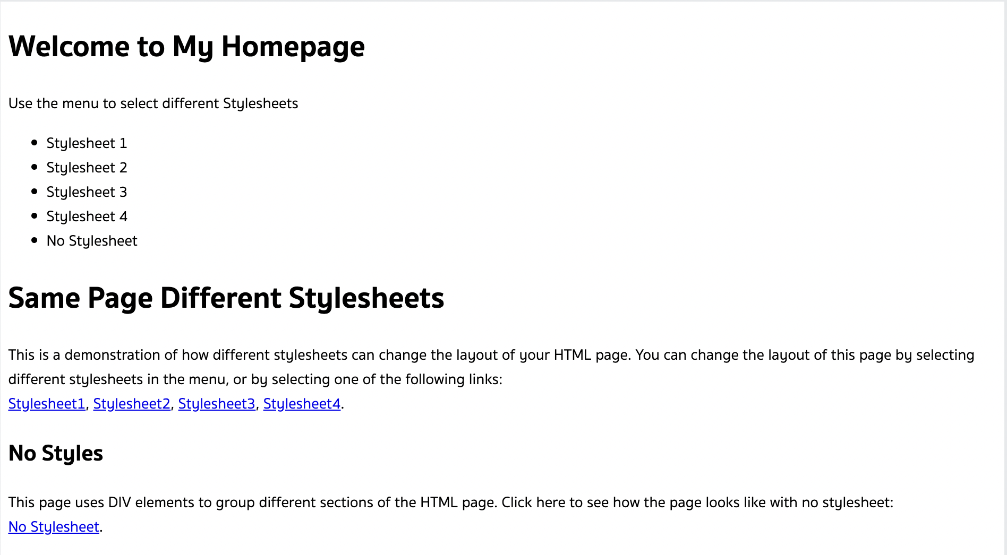
Lets test CSS

Slide 4
Agenda Today:
What is class and id in html
Basic Structure of CSS
Inline and external CSS
CSS terminolgies and box model
CSS selectors
Colors in CSS
Units in CSS
CSS layering with flexbox and Grid

Slide 5
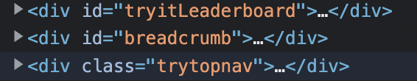
Class and ID in HTML
Class in HTML is used to group many HTML elements under a same name.
ID in HTML is used to uniquely identify HTML element with a name.
To assign a class to any html element, we write it the following way

Slide 6
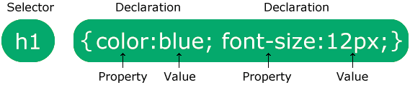
Basic Structure of CSS
CSS follows the following syntax/format
There are 3 sectors in the syntax. They are:
selectors: h1
Decleration Section:
Key: color, font-size
Value: blue, 12px
The selector points to the HTML element you want to style.
The declaration block contains one or more declarations separated by semicolons.
Each declaration includes a CSS property name and a value, separated by a colon.
Multiple CSS declarations are separated with semicolons, and declaration blocks are surrounded by curly braces.

Slide 7
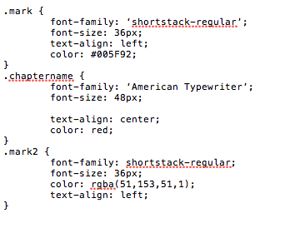
Basic Structure of CSS Continued
Let’s see an example of real world css
This is an example of CSS from one of the sites.
Lets analyze it.

Slide 8
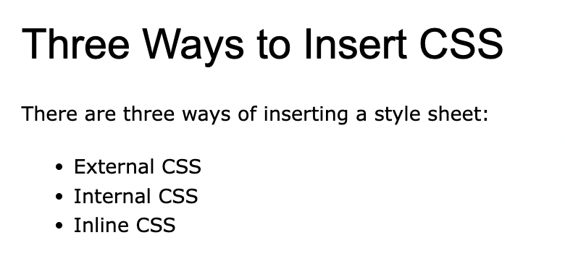
Lets link CSS into our site
CSS can be written in three ways.
CSS can be written inline, internal or using external CSS.
Inline CSS are written inside a html element using style attribute [ Not Recommended ]
Internal CSS are written inside of head tag with another tag called “style tag” [ Not Recommended ]
External CSS are written in a separate file ending with .css file and are linked into a HTML file using style tag. [ Recommended ]
Lets play with CSS and add basic styles in our website.

Slide 9
CSS terminologies and box models
Margins
Padding
Borders
Display
Colors
Height
Width
Z-Index
Position
Opacity

Slide 10
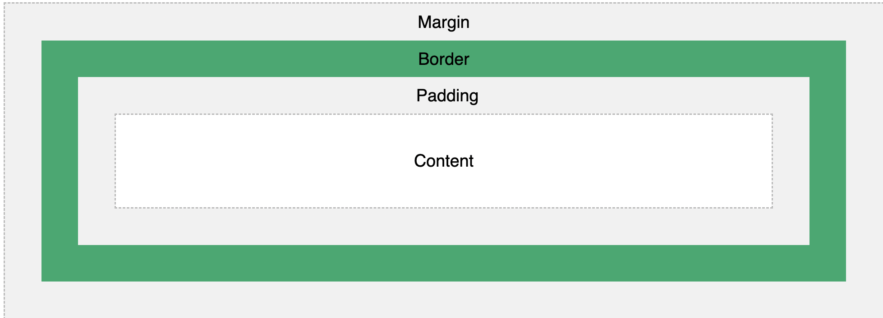
CSS terminologies and box models

Slide 11
CSS selectors
CSS selectors are used to select CSS elements such that you can apply styles to it.
To select elements by the html tag, you use the name of the tag
To select elements by the class attribute, you should use the .class_name
To select elements by the id attribute, you should use the #id_name

Slide 12
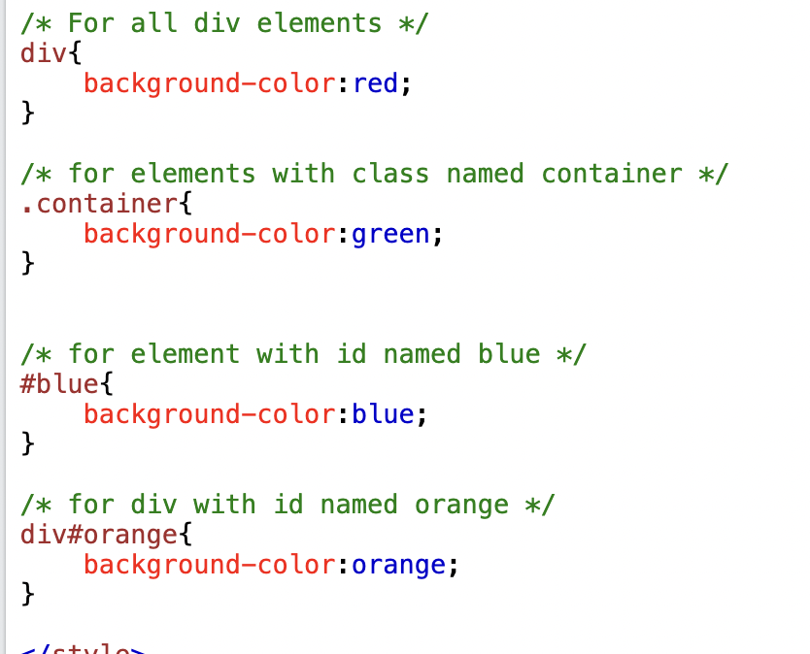
CSS selectors
Lets see the example in action
Lets set the background color
Content between /**/ are called comments and it will not disturb the execution

Slide 13
CSS colors
There are three ways to color elements in CSS
To color selected elements. We use either 3 of the types of coloring
Using RGB: RGB stands for Red-Blue-Green. Eg: RGB
Using HSL: HSL stands for Hue-Saturation-Lightness
Using Hex Color Codes: Hexadecimal Color Codes

Slide 14
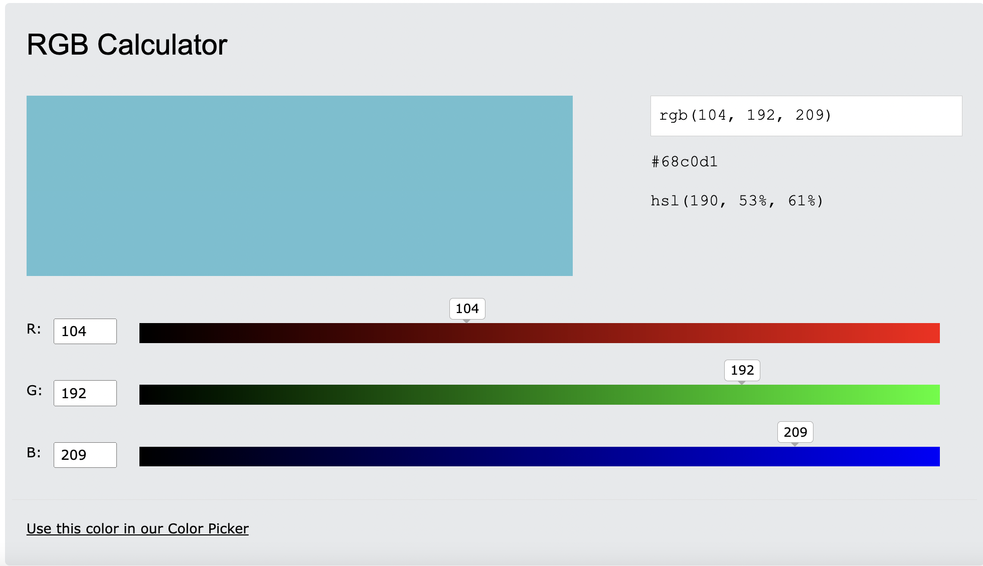
CSS colors
A color can be represented in every single way
Don’t remember color codes.
You can use color picker like shown aside

Slide 15
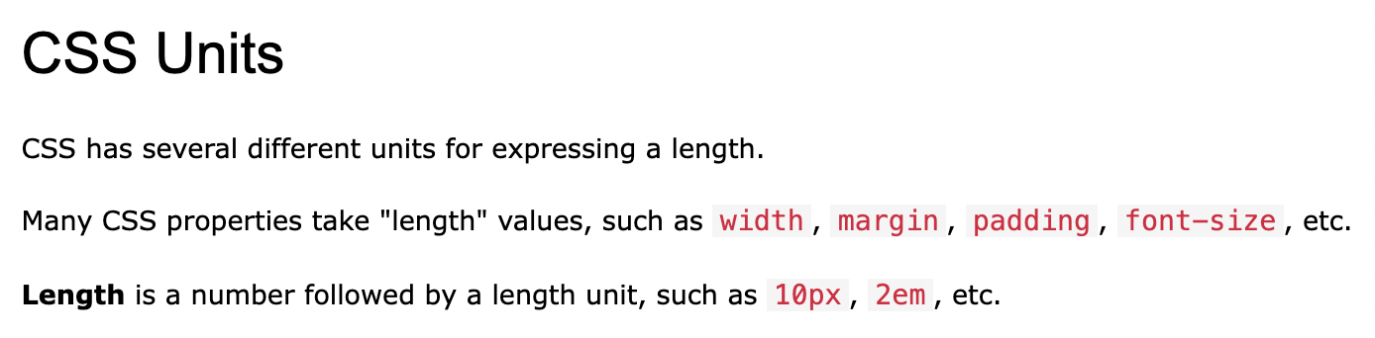
CSS units
In CSS, we can declare height and width with units like
cm
mm
pt
in
pc
px
vw
vh
%

Slide 16
Layering with CSS FlexBox
Before the Flexbox Layout module, there were four layout modes:
Block, for sections in a webpage
Inline, for text
Table, for two-dimensional table data
Positioned, for explicit position of an element
CSS flexbox is a way to layer elements
To use flexbox we have to set display:flex for an element
Refrence: https://www.w3schools.com/css/css3_flexbox.asp
Lets play with flexbox

Slide 17
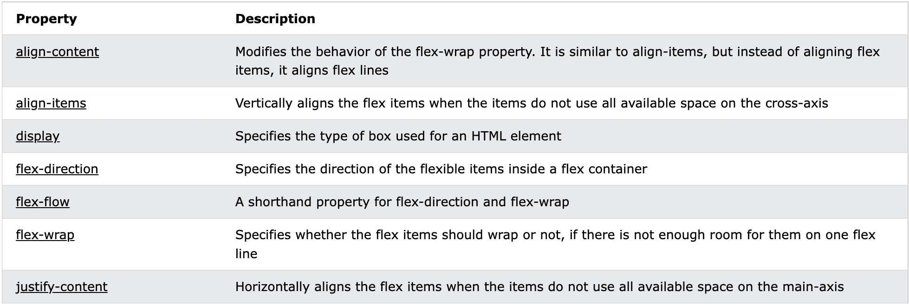
Properties of a flex element

Slide 18
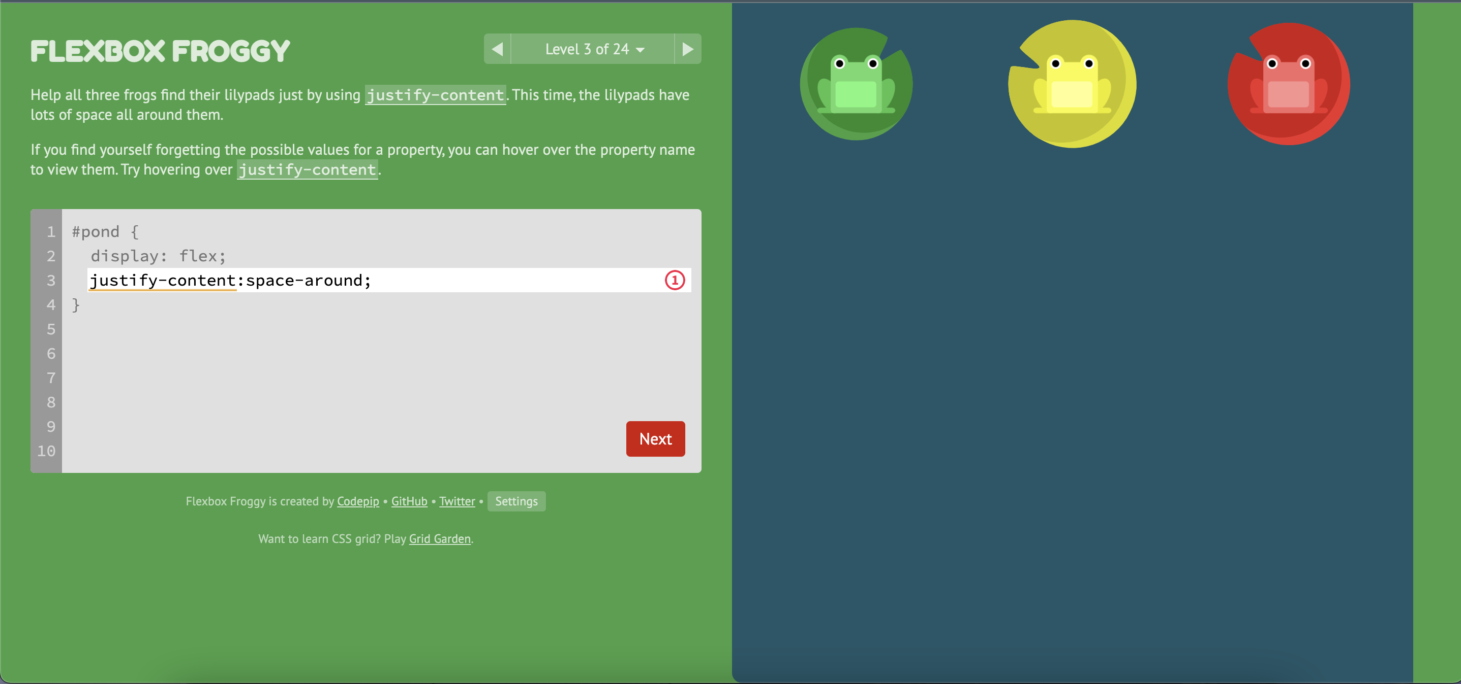
Flex Box Game

Slide 19
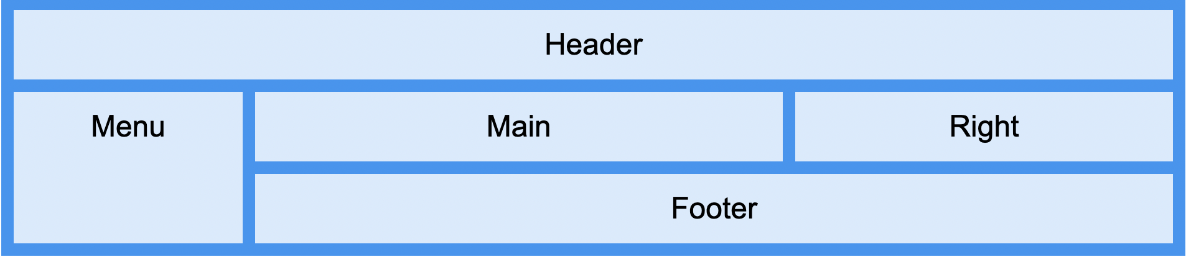
Grid Layering
The CSS Grid Layout Module offers a grid-based layout system, with rows and columns, making it easier to design web pages without having to use floats and positioning.

Slide 20
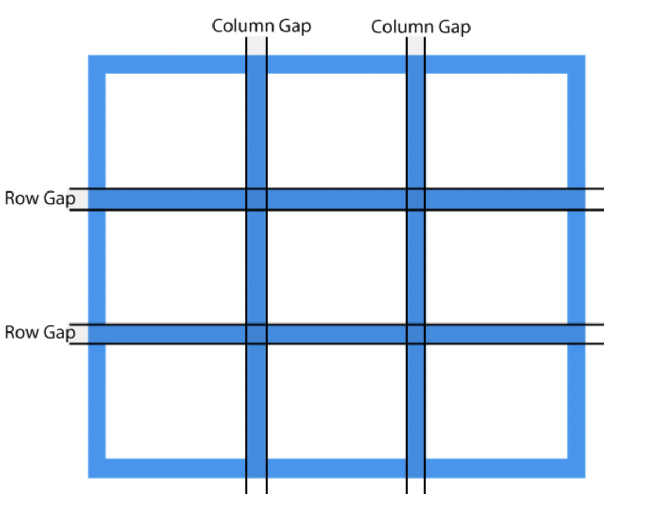
What is a Grid
Using Grid, we can divide our website into rows and columns just like a matrix.
We can add elements at the position and layer our website.
This is more effective way to layer our website.

Slide 21
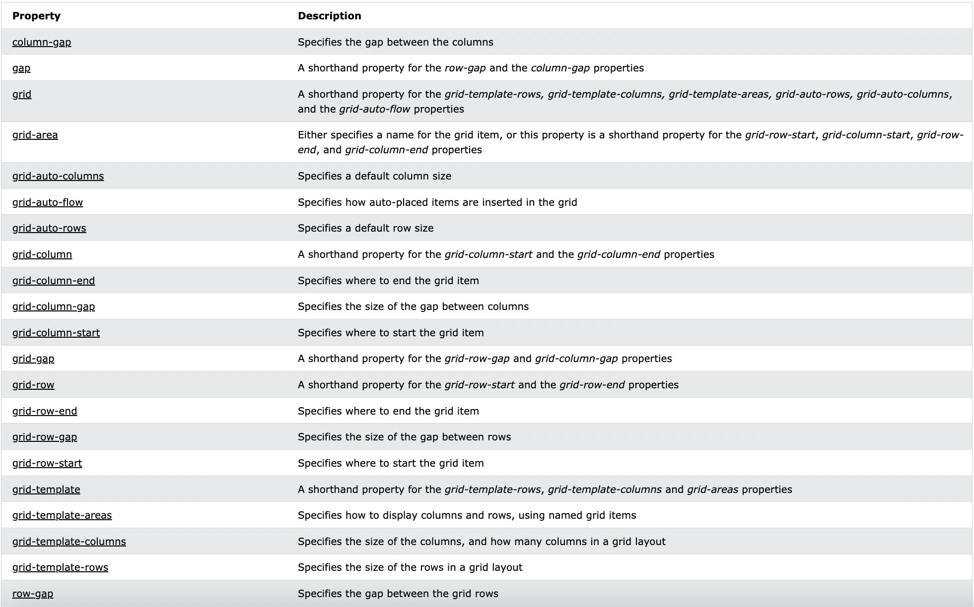
Grid Terminolgies

Slide 22
Similarities between Flex and Grid
Some properties from flexbox can be found in grid as well.
The properties that can be found are:
justify-content
align-content

Slide 23
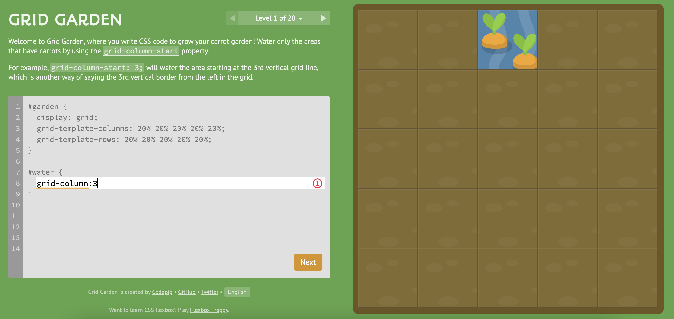
Learn grid by playing game

Slide 24
Resources:
Video Tutorials:
Flex box crash course
https://www.youtube.com/watch?v=JJSoEo8JSnc&ab_channel=TraversyMedia

Slide 25
End of day 2
Assignment:
Make a portfolio website about yourself using flexbox or grid:
Add your
Education
work experiences
contact info
Contact me form

